Slide 1
MGS 723: Geodynamics
Class 14: Finite Differences II
Content mainly sourced from Becker and Kaus, Numerical Geodynamics

Slide 2
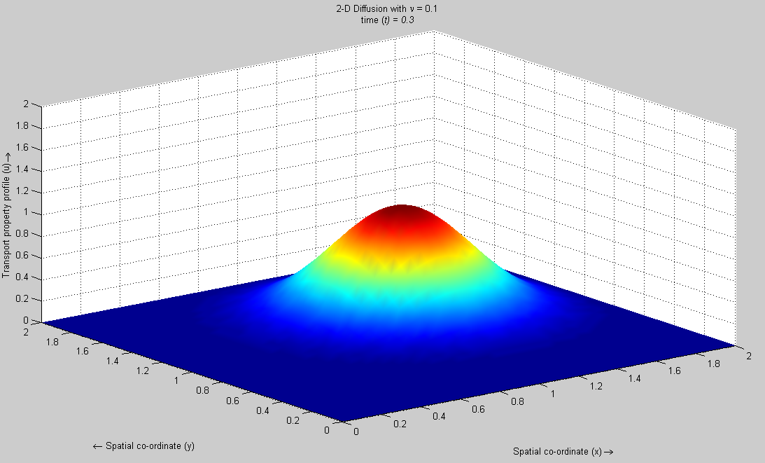
Today: Solving the heat equation using Finite Differences

Slide 3
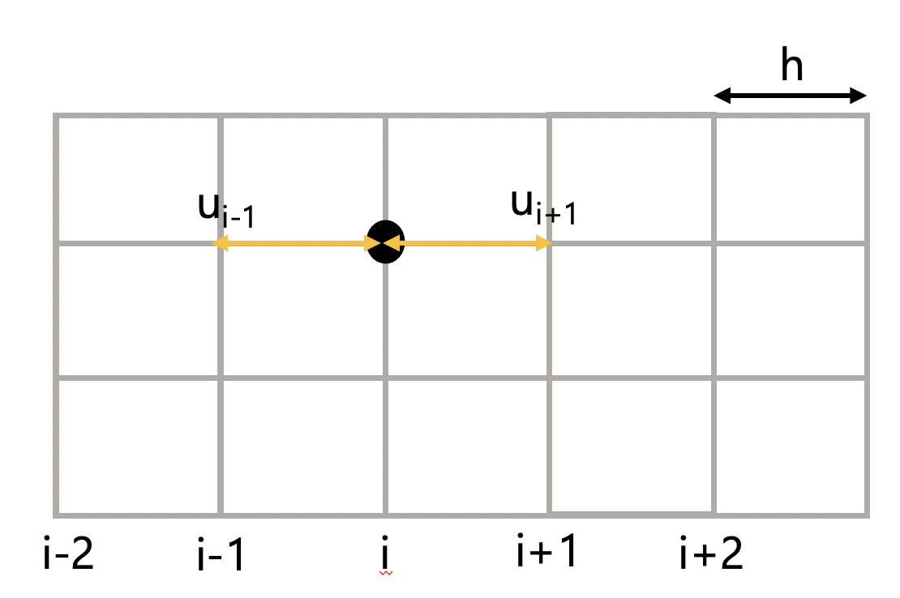
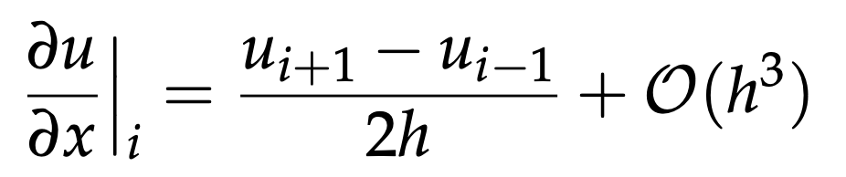
Recap: Discretizing derivatives
1st derivative (central difference, second order accuracy)
2

Slide 4
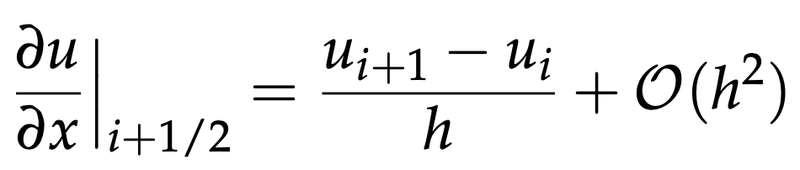
Recap: Discretizing derivatives
1st derivative (central difference, second order accuracy)
2
1st derivative (forward difference, first order accurate)

Slide 5
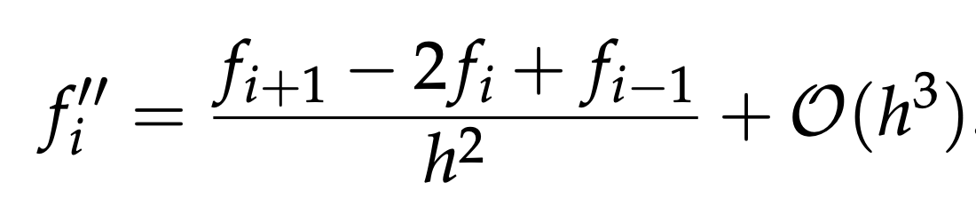
Recap: Discretizing derivatives
1st derivative (central difference, second order accuracy)
2
2nd derivative (central difference, second order accuracy)
f_{i-1}
f_{i}
f_{i+1}
2
i-2
i-1
i
i+1
i+2

Slide 6
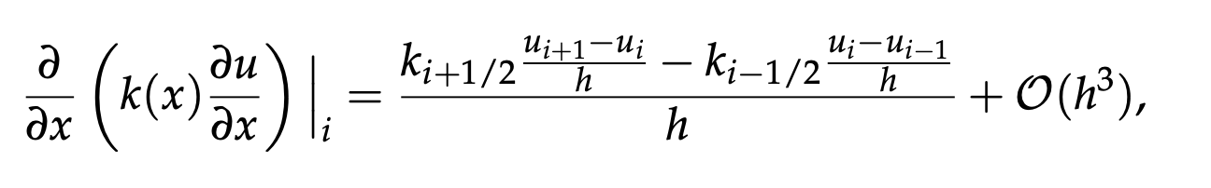
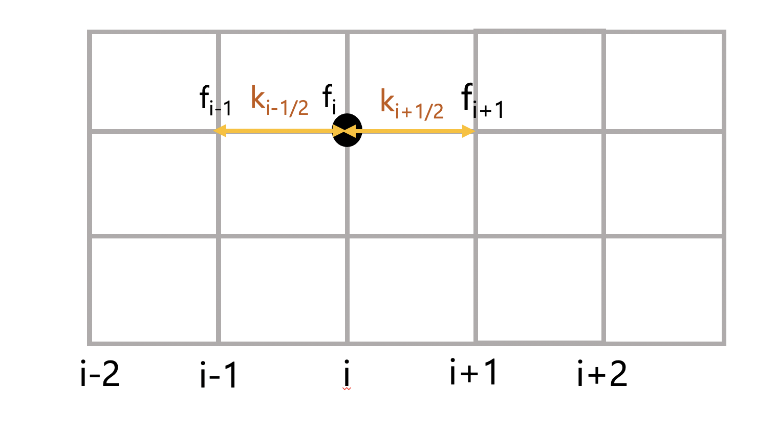
Recap: Variable coefficients
The second derivative with variable k can be written as following (to second order):
2

Slide 7
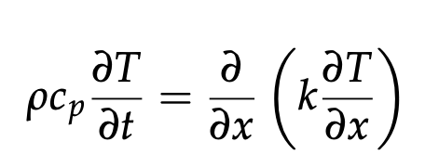
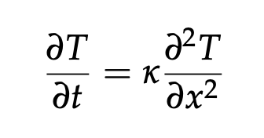
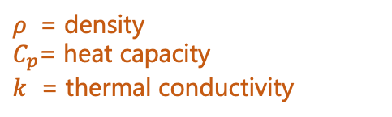
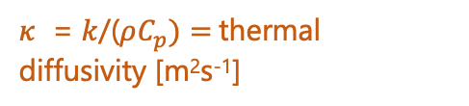
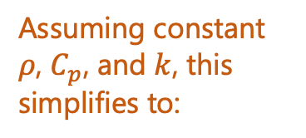
Discretizing the heat conduction equation
1-D, time dependent, conduction equation
$ρ$ = density
$C_{p}$= heat capacity
$k$ = thermal conductivity
Assuming constant $ρ$, $C_{p}$, and $k$, this simplifies to:
$κ$ = $k$/($ρC_{p})=$thermal diffusivity [m²s⁻¹]

Slide 8
Discretizing the heat conduction equation
1-D, time dependent, conduction equation
$ρ$ = density
$C_{p}$= heat capacity
$k$ = thermal conductivity
Assuming constant $ρ$, $C_{p}$, and $k$, this simplifies to:
$κ$ = $k$/($ρC_{p})=$thermal diffusivity [m²s⁻¹]
Goal: use FD to solve for T(x,t) assuming some initiation T(x,0)
1st step: Discretize the equation using the points on a grid.

Slide 9
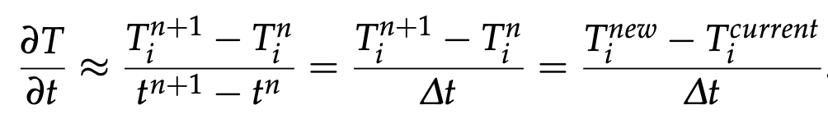
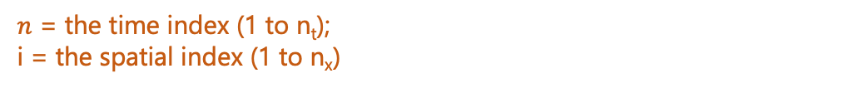
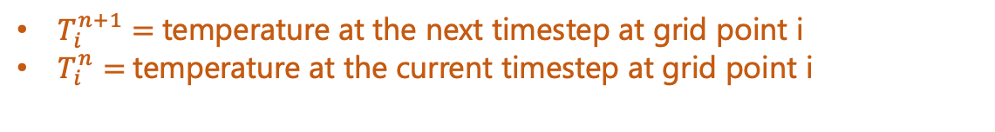
Discretizing the heat conduction equation
1-D, time dependent, conduction equation
$ρ$ = density
$C_{p}$= heat capacity
$k$ = thermal conductivity
Assuming constant $ρ$, $C_{p}$, and $k$, this simplifies to:
$κ$ = $k$/($ρC_{p})=$thermal diffusivity [m²s⁻¹]
Goal: use FD to solve for T(x,t) assuming some initiation T(x,0)
1st step: Discretize the equation using the points on a grid.
The time-derivative (left hand-side): (forward FD)
$n$ = the time index (1 to n_{t});
i = the spatial index (1 to n_{x})
$T_{i}^{n+1}=$temperature at the next timestep at grid point i
$T_{i}^{n}=$temperature at the current timestep at grid point i

Slide 10
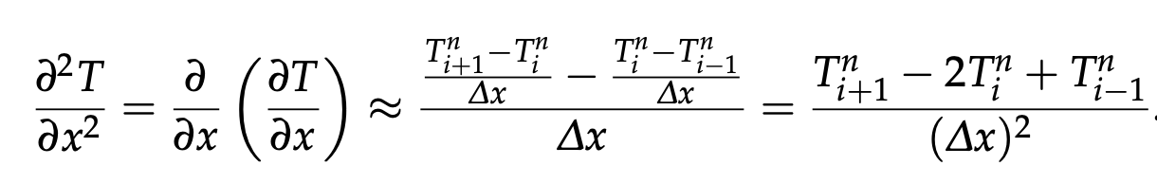
Discretizing the heat conduction equation
1-D, time dependent, conduction equation
$ρ$ = density
$C_{p}$= heat capacity
$k$ = thermal conductivity
Assuming constant $ρ$, $C_{p}$, and $k$, this simplifies to:
$κ$ = $k$/($ρC_{p})=$thermal diffusivity [m²s⁻¹]
Goal: use FD to solve for T(x,t) assuming some initiation T(x,0)
1st step: Discretize the equation using the points on a grid.
The time-derivative (left hand-side): (forward FD)
$n$ = the time index (1 to n_{t});
i = the spatial index (1 to n_{x})
The spatial-derivative (right hand-side): (central FD)

Slide 11
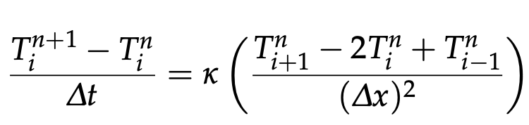
Discretizing the heat conduction equation
So, discretizing the equation:

Slide 12
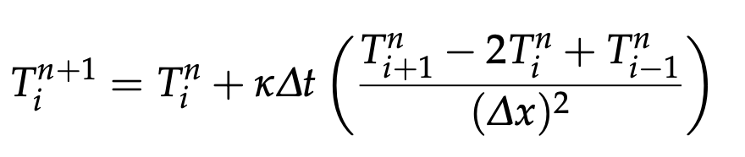
Discretizing the heat conduction equation
So, discretizing the equation:
Rearranging so that the temperature of the next time step (n+1), which we solve for, is on the left-hand side. On the right-hand side is the temperature of the current step, which we know.

Slide 13
Discretizing the heat conduction equation
So, discretizing the equation:
Rearranging so that the temperature of the next time step (n+1), which we solve for, is on the left-hand side. On the right-hand side is the temperature of the current step, which we know.
Because the spatial derivative was discretized at the current time (n), this is an example of the Explicit finite difference method.
I.e., we know the temperature at the current time-step (n) and use that to compute it at the next step (n+1)

Slide 14
Discretizing the heat conduction equation
So, discretizing the equation:
Rearranging so that the temperature of the next time step (n+1), which we solve for, is on the left-hand side. On the right-hand side is the temperature of the current step, which we know.
Because the spatial derivative was discretized at the current time (n), this is an example of the Explicit finite difference method.
I.e., we know the temperature at the current time-step (n) and use that to compute it at the next step (n+1)
What is the accuracy of this solution?

Slide 15
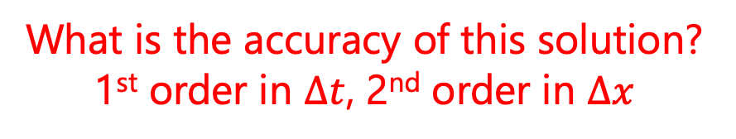
Discretizing the heat conduction equation
So, discretizing the equation:
Rearranging so that the temperature of the next time step (n+1), which we solve for, is on the left-hand side. On the right-hand side is the temperature of the current step, which we know.
Because the spatial derivative was discretized at the current time (n), this is an example of the Explicit finite difference method.
I.e., we know the temperature at the current time-step (n) and use that to compute it at the next step (n+1)
What is the accuracy of this solution?
1st order in $∆t$, 2nd order in $∆x$

Slide 16

Discretizing the heat conduction equation
Explicit finite differences
1st order in $∆t$,
2nd order in $∆x$

Slide 17
Discretizing the heat conduction equation
Explicit finite differences
1st order in $∆t$,
2nd order in $∆x$
Explicit finite differences (as opposed to implicit finite differences) are relatively simple to set up as only one temperature solution needs to be stored (i.e., the previous one, here T ^{n})

Slide 18
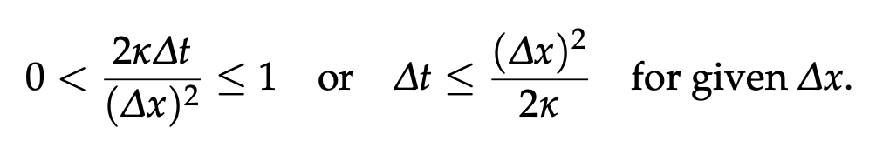
Discretizing the heat conduction equation
Explicit finite differences
1st order in $∆t$,
2nd order in $∆x$
Explicit finite differences (as opposed to implicit finite differences) are relatively simple to set up as only one temperature solution needs to be stored (i.e., the previous one, here T ^{n})
But a major drawback is that the explicit FD solution is only conditionally stable. If the following stability criterion is not satisfied, the solution oscillates wildly (“blows up”):
(Criterion can be derived from a von Neumann stability analysis of the PDE)
Notes:
However, phys- ically, the stability condition eq. (4.41) means that the maximum time step needs to be smaller than the time it takes for an anomaly to diffuse across the grid (nodal) spacing ∆x (cf. diffusion time in sec. 3.3).

Slide 19
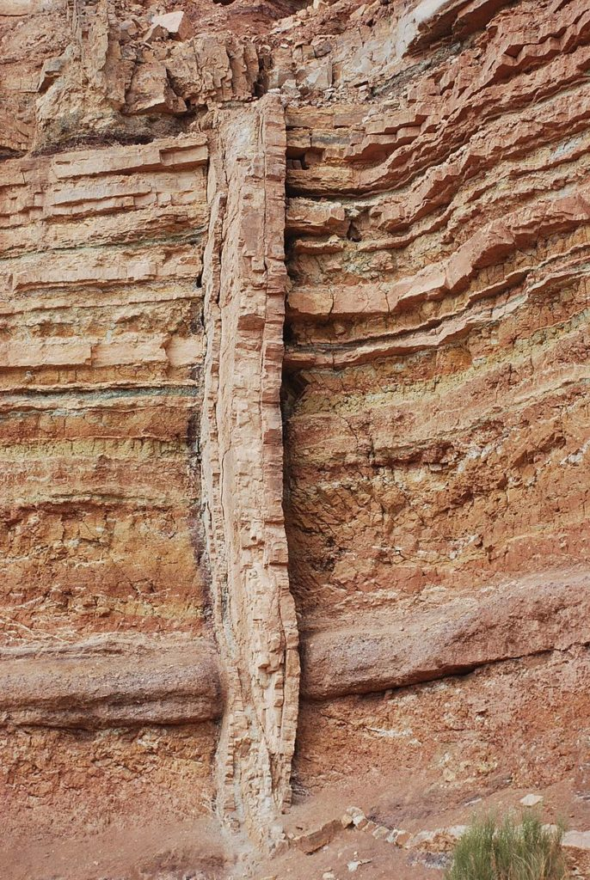
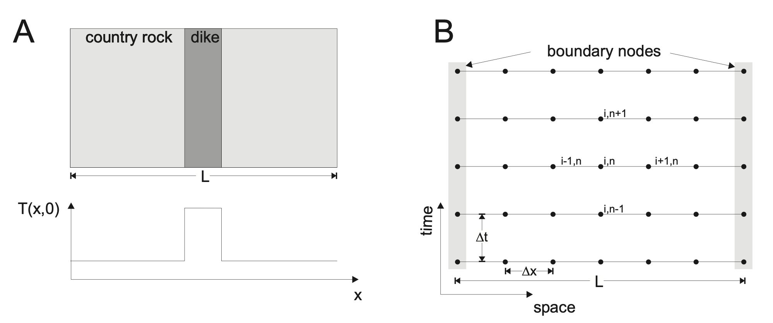
Exercise #3: Conductive cooling of a dike in 1-D
The physical problem

Slide 20
Exercise #3: Conductive cooling of a dike in 1-D
The physical problem
The numerical grid
The discretized equation (explicit FD method)

Slide 21
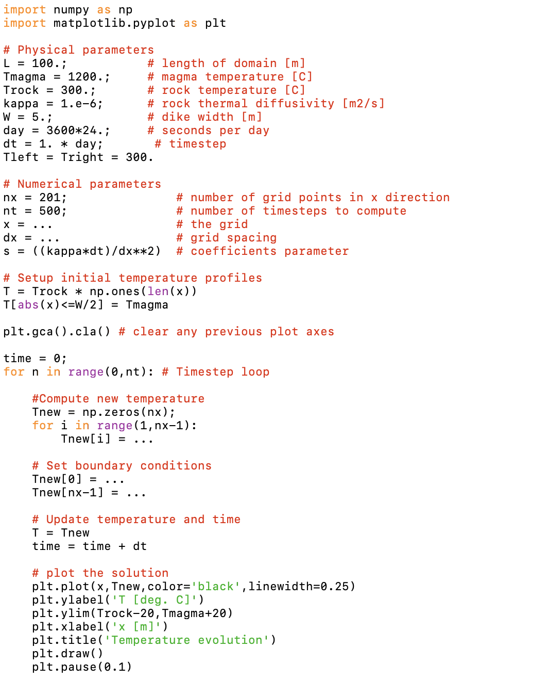
Exercise #3: Conductive cooling of a dike in 1-D
Explicit FDs
Code stencil:

Slide 22
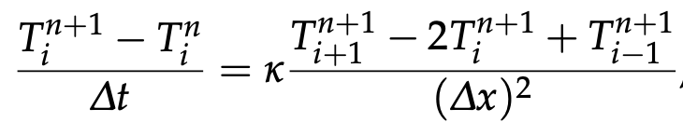
Discretizing the heat conduction equation: Implicit FDs
Because the spatial derivative is evaluated at the new time-step (n+1), this is an example of the Implicit finite difference method.

Slide 23
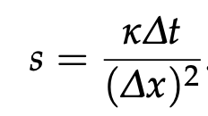
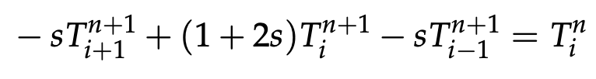
Discretizing the heat conduction equation: Implicit FDs
Because the spatial derivative is evaluated at the new time-step (n+1), this is an example of the Implicit finite difference method.
Rearranging so known terms are on the right (i.e., current temperatures), unknown terms are on the left (i.e., next step temperatures)
with

Slide 24
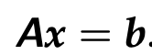
Discretizing the heat conduction equation: Implicit FDs
Because the spatial derivative is evaluated at the new time-step (n+1), this is an example of the Implicit finite difference method.
Rearranging so known terms are on the right (i.e., current temperatures), unknown terms are on the left (i.e., next step temperatures)
We no longer have an explicit relationship for T ^{n+1}. Rather, we must solve a linear set of equations, which can be written as:
with
Mainly coefficients of linear equations (here, -s and 1+2s) and to deal with boundary conditions.
Old (n) temperatures that form right-hand side of above equation
New (n+1) temperatures. To solve for!

Slide 25
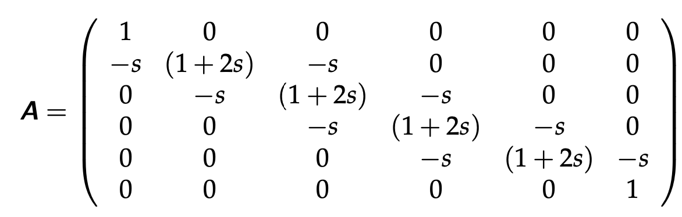
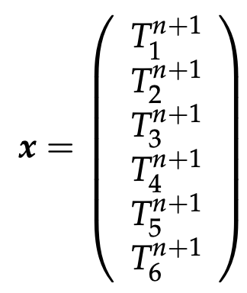
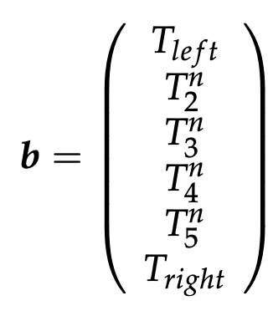
Discretizing the heat conduction equation: Implicit FDs

Slide 26
Discretizing the heat conduction equation: Implicit FDs
In order:

Slide 27
Discretizing the heat conduction equation: Implicit FDs
In order:
Note: sets constant T boundary conditions

Slide 28
Discretizing the heat conduction equation: Implicit FDs
In order:
A is a “sparse” matrix (most off-diagonals are zero). Can be exploited numerically

Slide 29
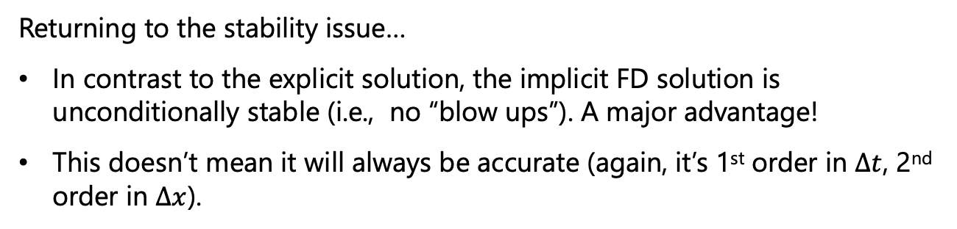
Discretizing the heat conduction equation: Implicit FDs
In order:
Returning to the stability issue…
In contrast to the explicit solution, the implicit FD solution is unconditionally stable (i.e., no “blow ups”). A major advantage!
This doesn’t mean it will always be accurate (again, it’s 1st order in $∆t$, 2nd order in $∆x$).

Slide 30
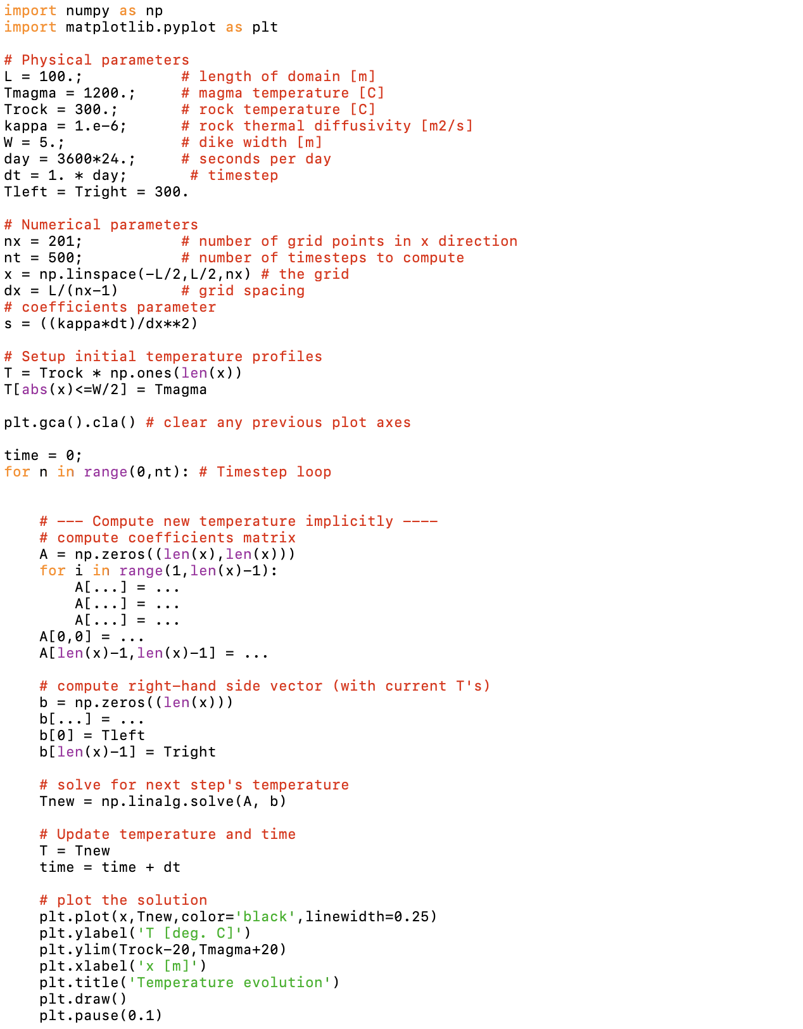
Exercise #3: Conductive cooling of a dike in 1-D
Implicit FDs
Code stencil:

Slide 31
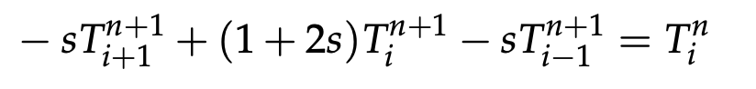
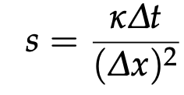
With variable coefficients
Constant diffusivity case (as before):
where

Slide 32
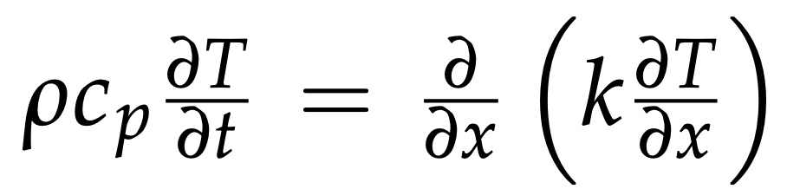
With variable coefficients
Constant diffusivity case (as before):
where
Spatially variable conductivity, i.e.:

Slide 33
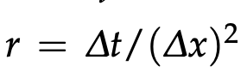
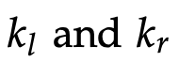
With variable coefficients
Constant diffusivity case (as before):
where
Spatially variable conductivity, i.e.:
where and are coefficients to the
left and right of i, respectively

Slide 34
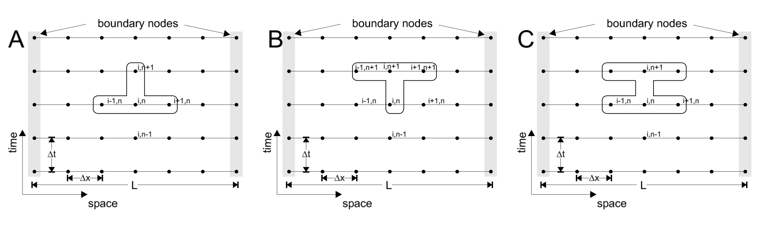
Different discretization schemes
Crank-Nicholson FD
discretization
Explicit FD discretization
O($∆t)$, O($∆x^{2})$
O($∆t)$, O($∆x^{2})$
Implicit FD discretization

Slide 35
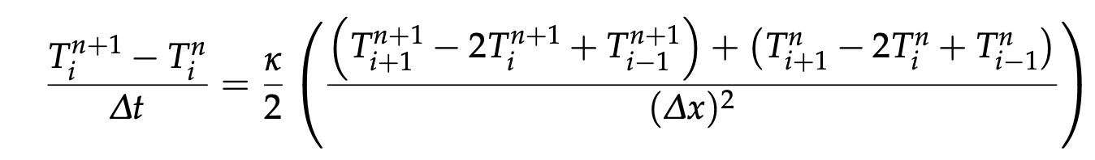
Different discretization schemes
Crank-Nicholson FD
discretization
O($∆t^{2})$, O($∆x^{2})$
Crank-Nicholson combines the explicit and implicit spatial derivatives (i.e., is “partially implicit”) to get the best accuracy

Slide 36
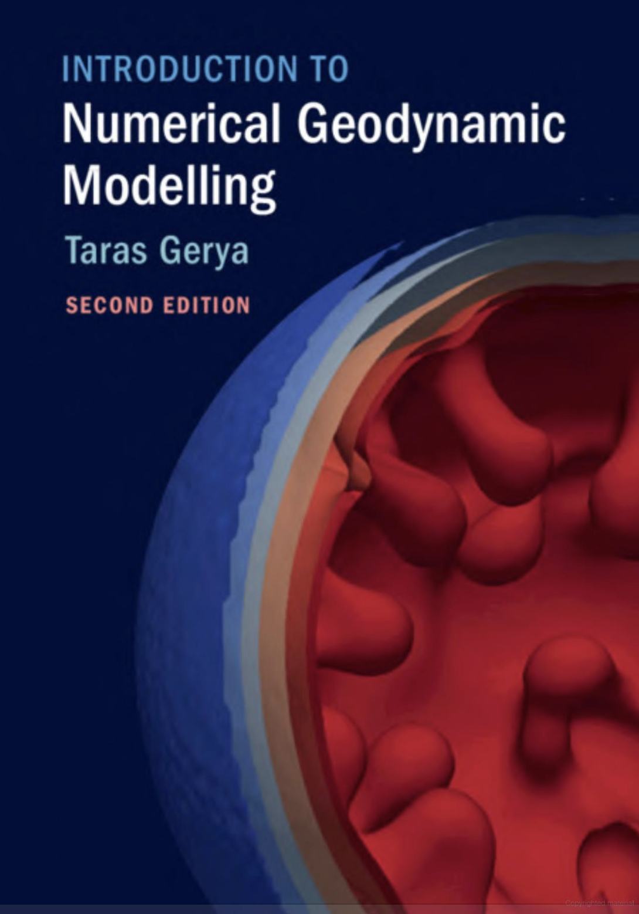
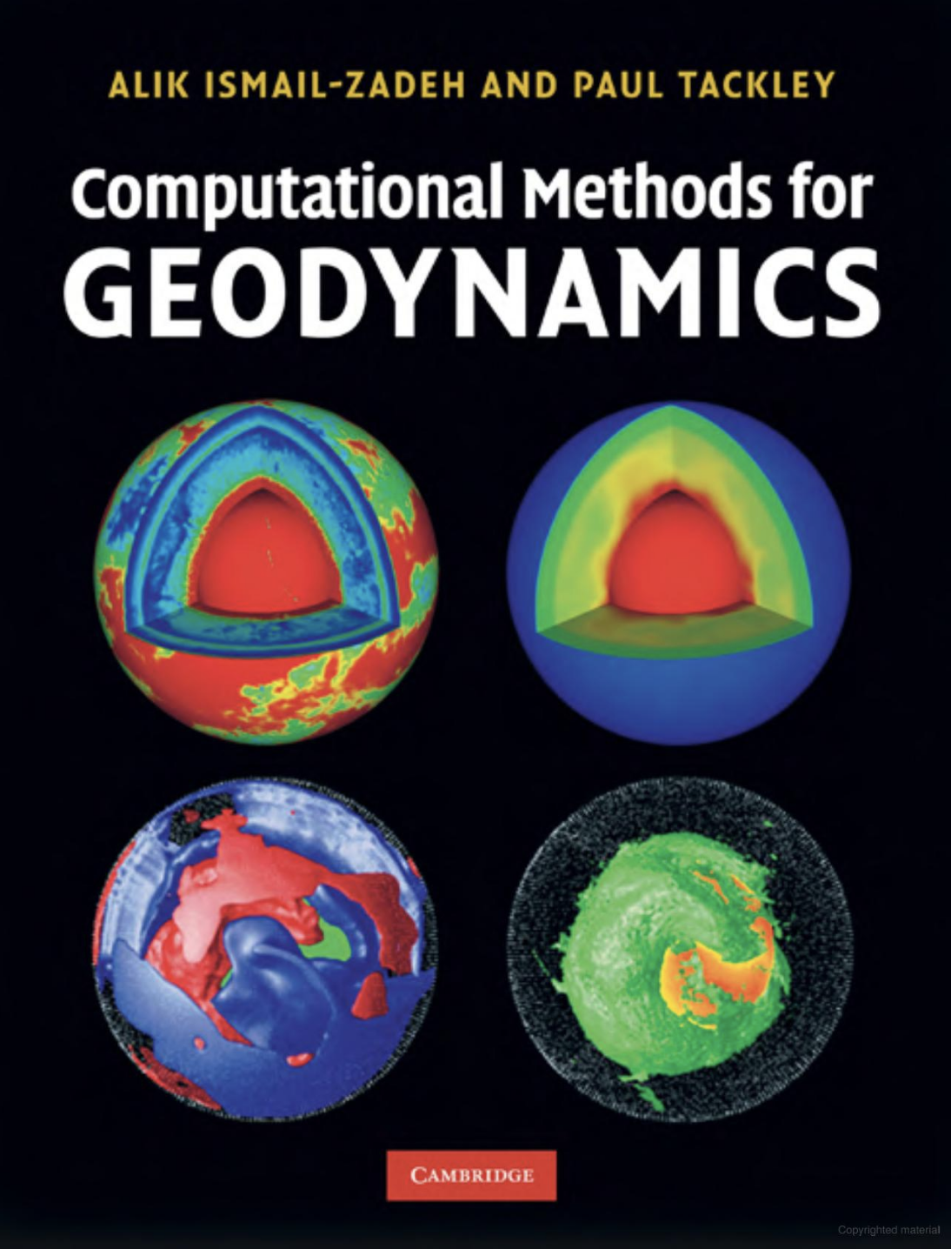
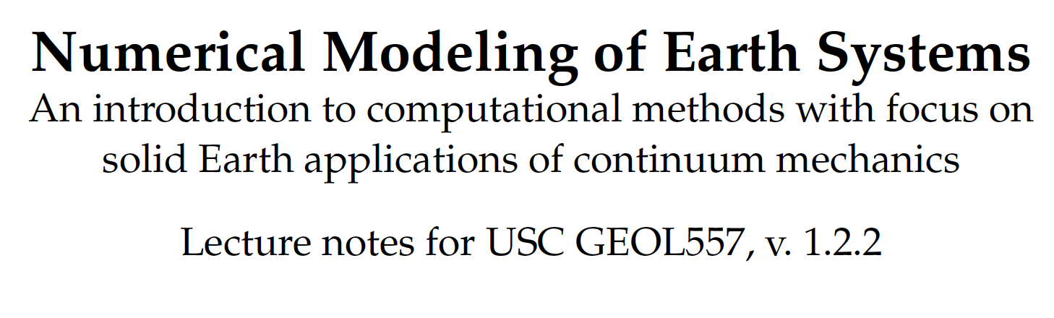
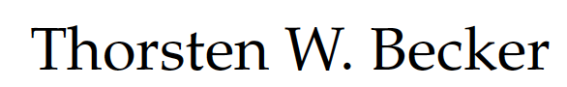
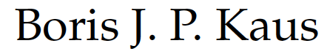
Numerical geodynamics resources
Finite difference method
Modeling overview
Today:
Sects. 4.2-4.4
http://www-udc.ig.utexas.edu/external/becker/Geodynamics557.pdf

Slide 37
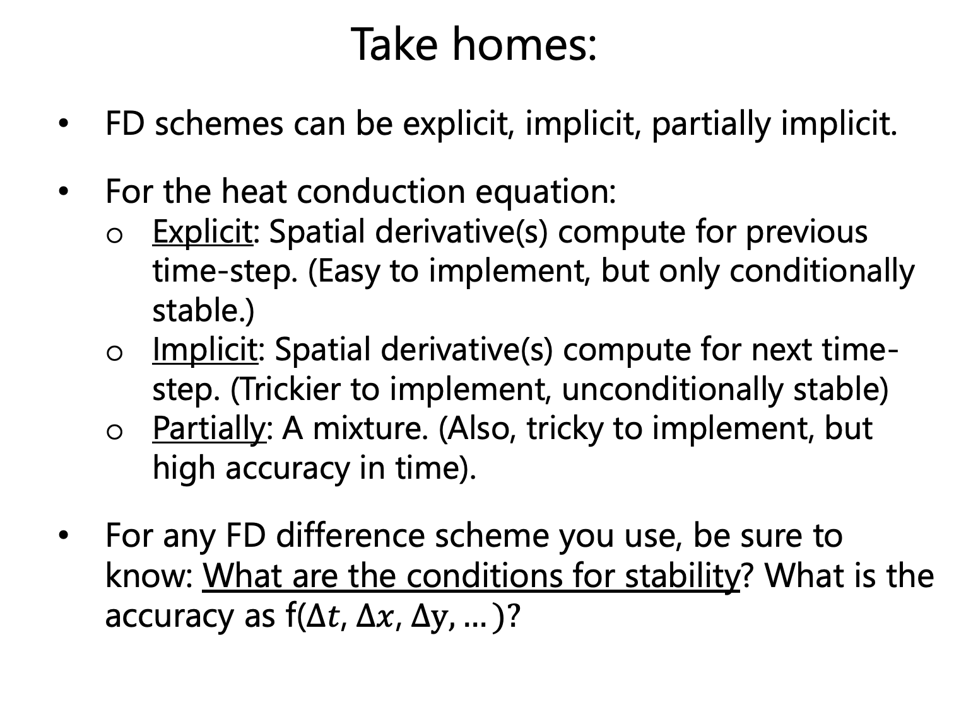
Take homes:
FD schemes can be explicit, implicit, partially implicit.
For the heat conduction equation:
Explicit: Spatial derivative(s) compute for previous time-step. (Easy to implement, but only conditionally stable.)
Implicit: Spatial derivative(s) compute for next time-step. (Trickier to implement, unconditionally stable)
Partially: A mixture. (Also, tricky to implement, but high accuracy in time).
For any FD difference scheme you use, be sure to know: What are the conditions for stability? What is the accuracy as f($∆t$, $∆x$, $∆y,…)?$

